Slide 1


ADVANCED SCALABLE AND SECURE NETWORK ARCHITECTURE FOR BANK AND ITS BRANCHES

Slide 2

CONTENT OF
TABLE
INTRODUCTION
PROJECT REQUIREMENTS AND SCOPE
NETWORK DESIGN
REDUNDANCY AND HIGH AVAILABILITY
SECURITY FEATURES
SCALABILITY AND FUTURE GROWTH
SIMULATION IN CISCO PACKET TRACER
CHALLENGES AND SOLUTIONS
CONCLUSION

Slide 3

INTRODUCTION
OBJECTIVE:
Design a secure, scalable, and redundant network infrastructure for a bank’s headquarter and branches.
WHY IT MATTERS:
Financial institutions require highly reliable and secure networks to support daily operations and protect sensitive data.
Ensuring high availability and robust security is critical to avoid downtime and data breaches in the banking sector.

Slide 4
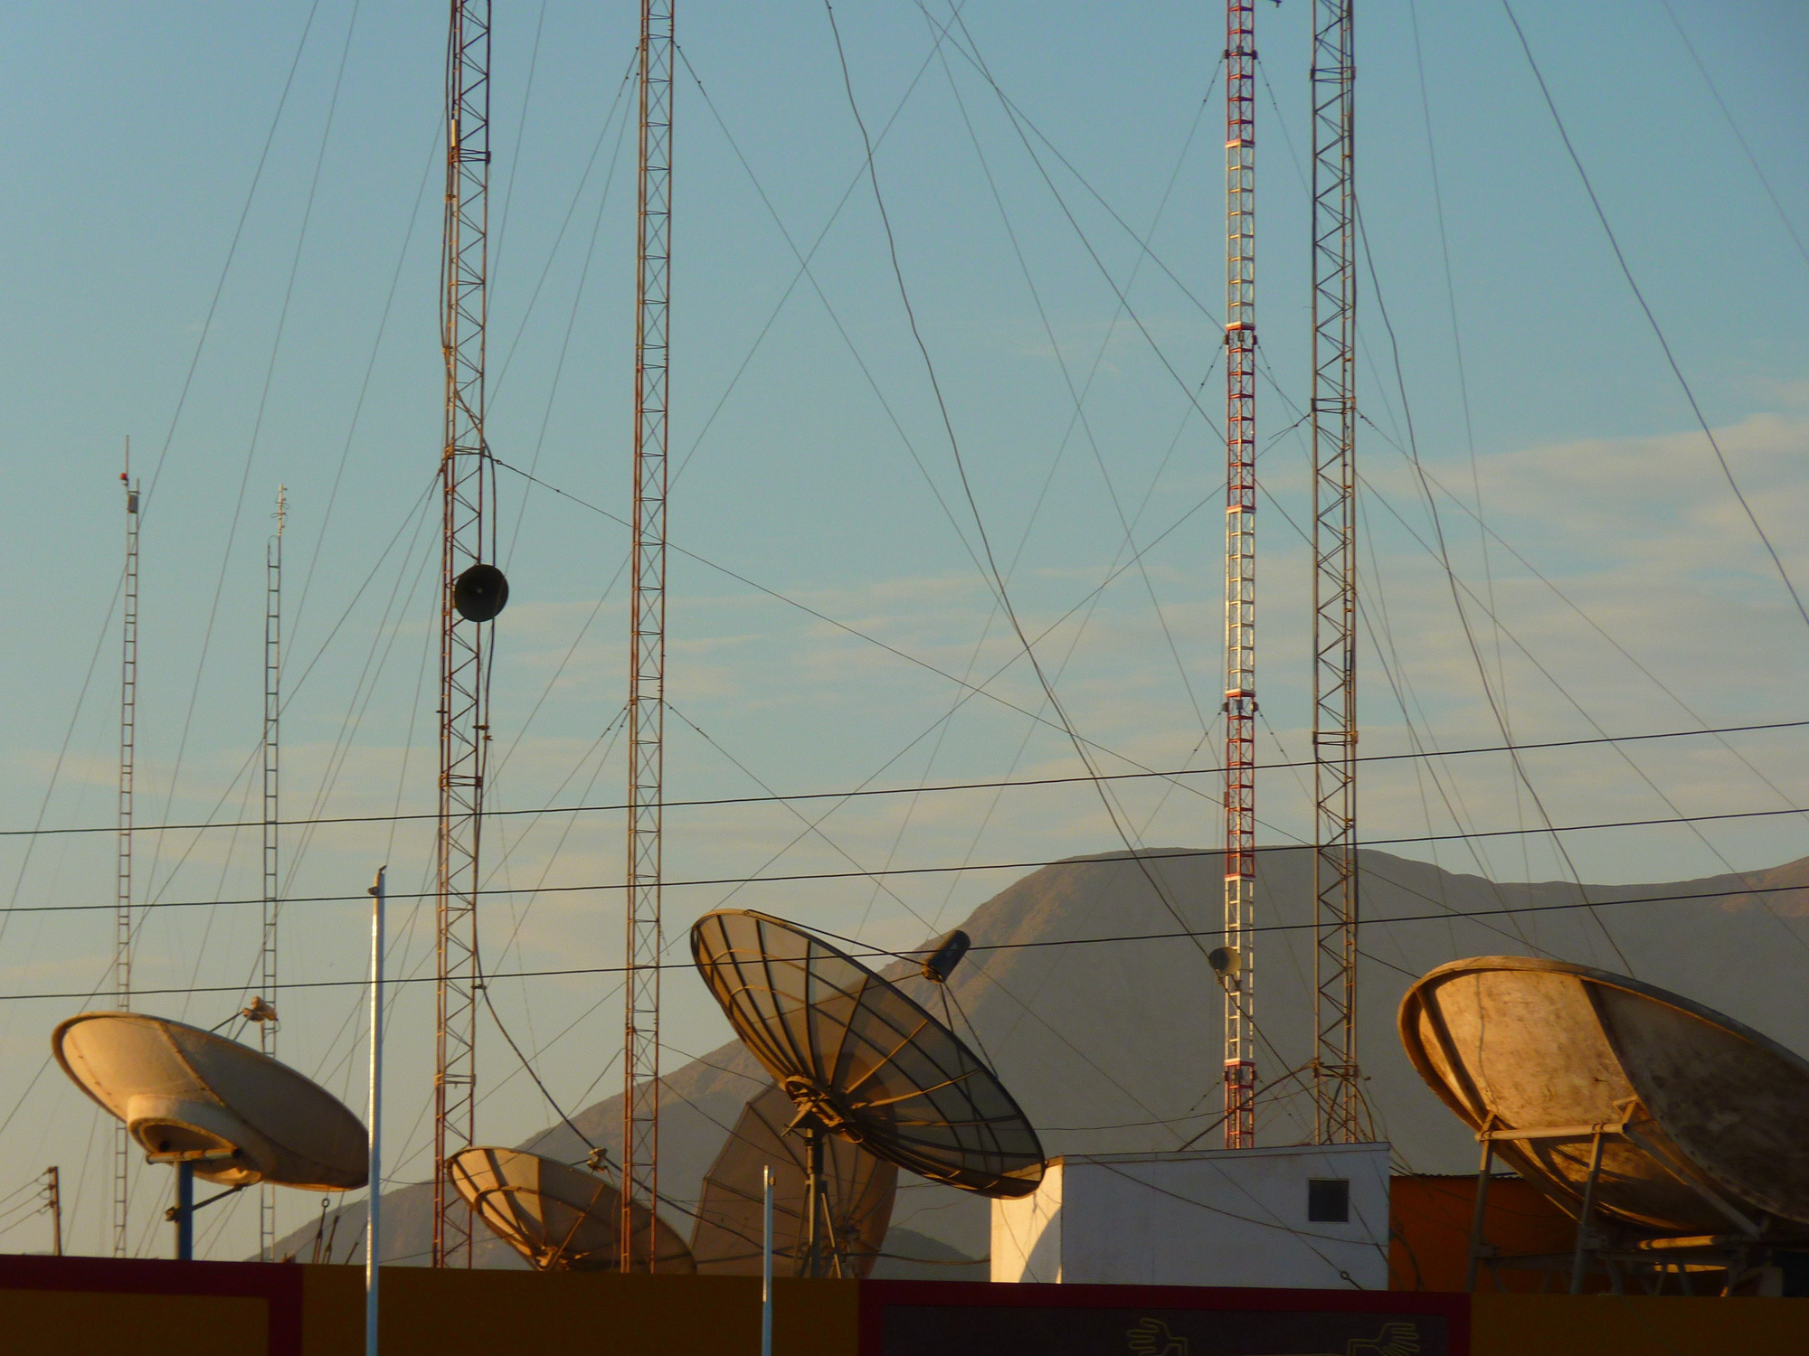
PROJECT REQUIREMENTS AND SCOPE
SOFTWARE:
CISCO PACKET TRACER (SIMULATED ENVIRONMENT)
Key Design Focus:
Three-tier architecture: Core, distribution, and access layers.
VLANs for traffic segmentation and security.
Redundancy through HSRP and EtherChannel.
Security protocols such as AAA, DHCP Snooping, and IP Source Guard.
Goal:
Build a network that meets the bank’s present needs and can scale as the organization grows.

Slide 5
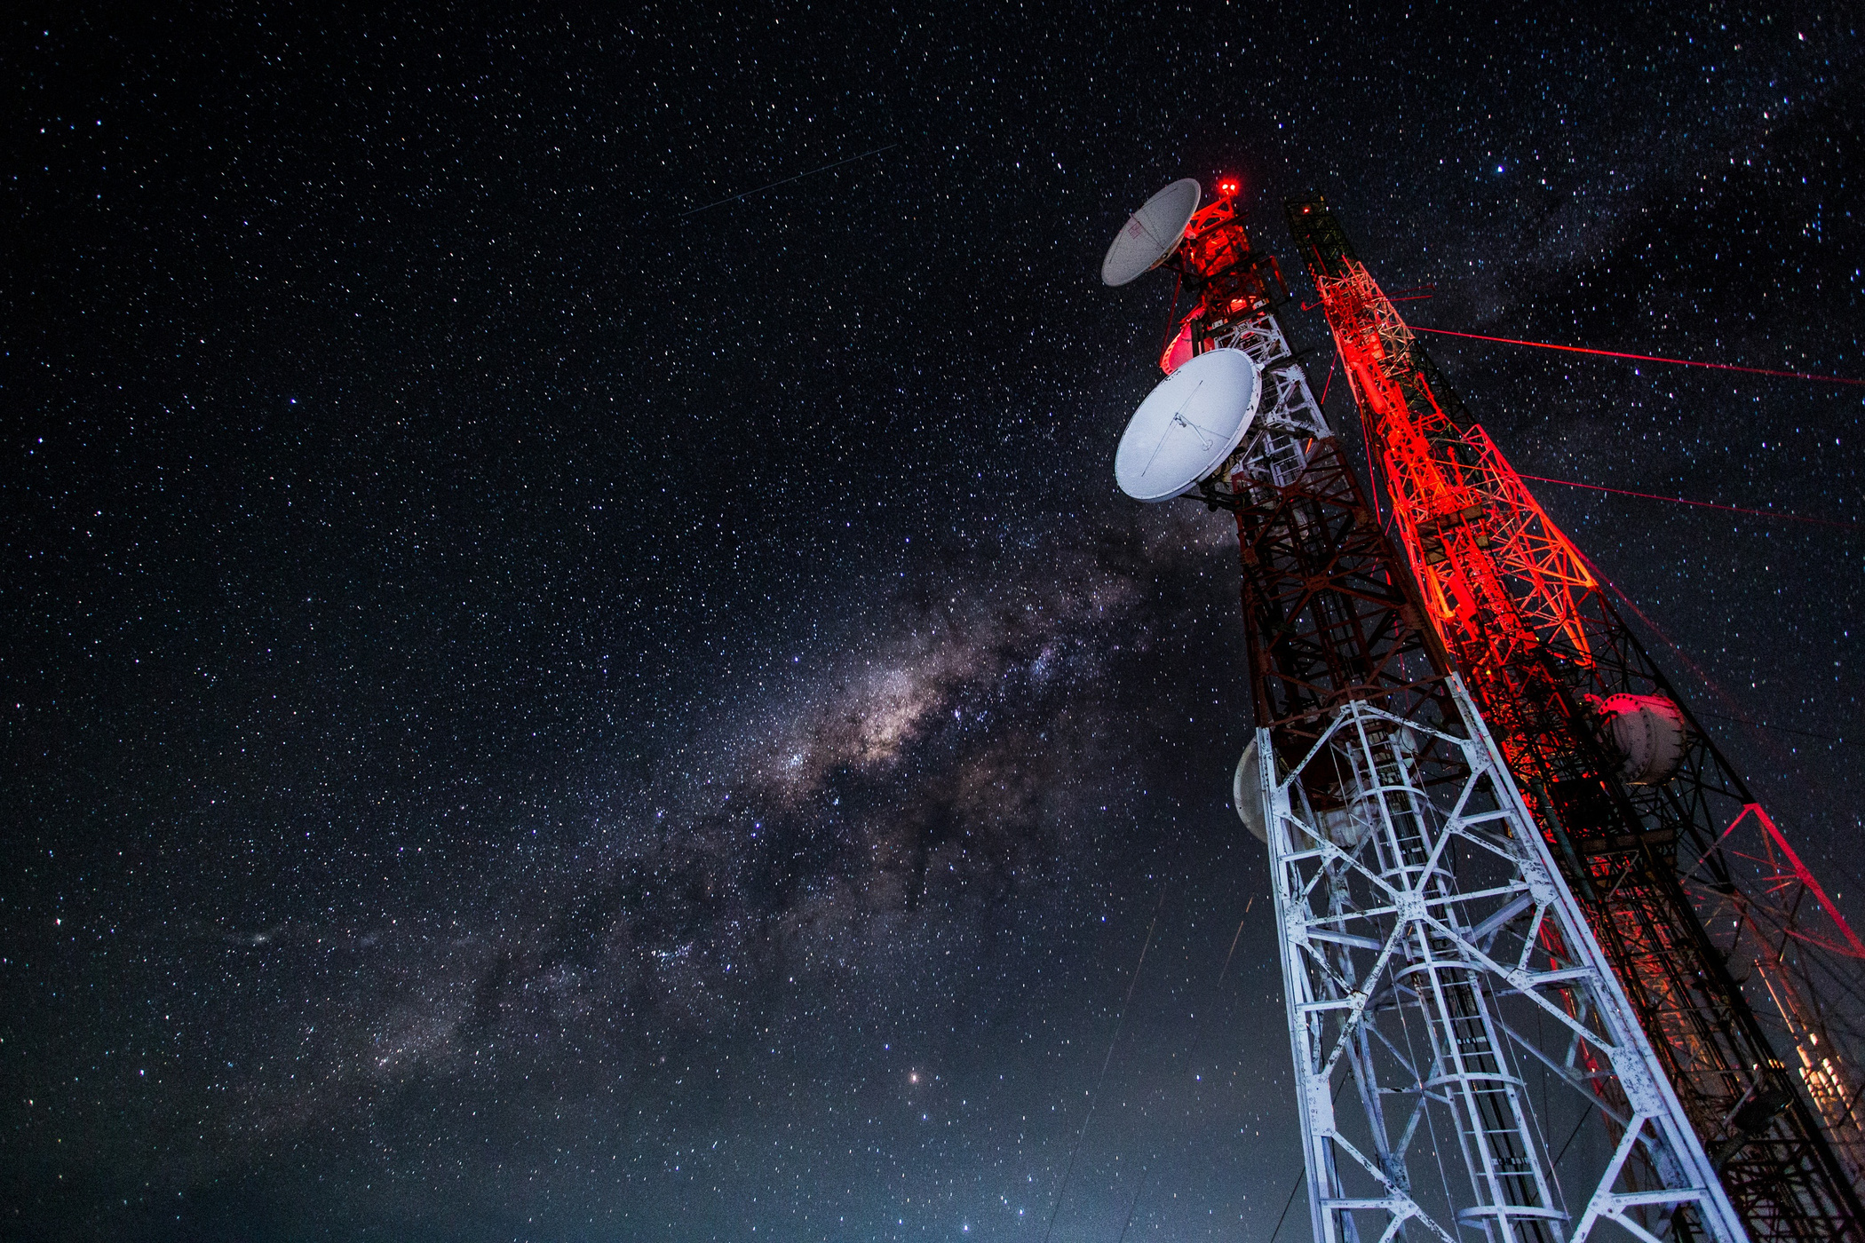
NETWORK DESIGN
THREE-TIER ARCHITECTURE:
Core Layer: Handles high-speed data transmission between branches.
Distribution Layer: Manages VLANs and routing between segments.
Access Layer: Connects end-user devices and applies security policies.
VLAN and Subnetting:
Separate VLANs for departments, ensuring better traffic management and security.
Structured IP addressing and subnetting for efficient device management.

Slide 6


REDUNDANCY AND HIGH AVAILABILITY
HSRP (HOT STANDBY ROUTER PROTOCOL):
Ensures gateway redundancy—one router acts as active, the other as standby, ensuring no downtime if one fails.
EtherChannel:
Link aggregation to increase bandwidth and provide redundancy by bundling multiple physical links.
OSPF Routing:
Dynamic routing between headquarter and branches, ensuring efficient traffic flow and fast failover.

Slide 7

SECURITY FEATURES
AAA AUTHENTICATION:
Centralized authentication using RADIUS servers for controlling user and device access.
DHCP Snooping:
Prevents rogue DHCP servers from assigning unauthorized IP addresses.
Dynamic ARP Inspection (DAI):
Protects against ARP spoofing attacks by verifying ARP packets.
IP Source Guard and Port Security:
Prevents IP spoofing and restricts unauthorized devices from connecting to the network.

Slide 8

SCALABILITY AND FUTURE GROWTH
MODULAR DESIGN:
The network is built to support future expansions, such as adding more branches or devices.
VTP Version 3:
Simplifies VLAN management across all switches, ensuring VLANs are consistently propagated.
OSPF Flexibility:
Dynamic routing enables easy integration of new locations without major reconfiguration.

Slide 9

INTERNET HARDWARE,SOFTWARE,AND SERVICES
PRESENTATIONS ARE COMMUNICATION TOOLS THAT CAN BE USED AS LECTURES, SPEECHES, REPORTS, AND MORE. MOST OF THE TIME, THEY'RE PRESENTED BEFOR AN AUDIENCE.
PRESENTATIONS ARE COMMUNICATION TOOLS THAT CAN BE USED AS LECTURES, SPEECHES, REPORTS, AND MORE. MOST OF THE TIME, THEY'RE PRESENTED BEFOR AN AUDIENCE.

Slide 10

TESTING IN CISCO PACKET TRACER
WHY PACKET TRACER?:
Simulates real-world scenarios without requiring physical hardware.
Allows us to test routing, security, and redundancy protocols.
Testing Procedures:
Simulated failover for HSRP and EtherChannel.
Verified security protocols, including DHCP Snooping and IP Source Guard.

Slide 11
CHALLENGES AND SOLUTIONS
CHALLENGE 1:
ENSURING SEAMLESS FAILOVER DURING DOWNTIME.
Solution: Implemented HSRP and EtherChannel to provide automatic redundancy.
Challenge 2:
Securing the network against internal and external threats.
Solution: Applied advanced security protocols (AAA, DAI, DHCP Snooping).
Challenge 3:
Designing for future scalability.
Solution: Built a modular design with OSPF and VTP, enabling easy expansion.

Slide 12
CONCLUSION
SUMMARY:
THE NETWORK DESIGN DELIVERS HIGH AVAILABILITY, ROBUST SECURITY, AND SCALABILITY FOR FUTURE GROWTH.
REDundancy mechanisms such as HSRP and EtherChannel ensure minimal downtime.
Advanced security features protect sensitive banking operations.
Looking Ahead:
The network can easily scale to accommodate additional branches or services as the bank grows.
This design is ready for future enhancements, ensuring long-term stability and reliability.

Slide 13
THANK YOU

